Slide 1
Secret Frames
Aditya Basta - 19BCE1287
Ayyappan K M - 19BCE1410
S Naman - 19BCE1491

Slide 2
Abstract
Internet is has grown wildly over the past few years and so has the number of users who use it on a daily basis. Every day 2.5 quintillion bytes of data are generated which is accessed and shared over the internet and hence comes the question of the security of that data that needs to be shared.
This has led to various encryption techniques and protocols being developed to secure data. One of which is steganography. Steganography is the technique of hiding secret data with ordinary data, files, or messages to avoid detection from unintended entities. Video steganography is a method used to hide secret data such as a message or a photo in a cover multimedia file like a video file.
Video files are very suitable for hiding data because of the large number of frames and the ability to make minor changes to each frame. We have mainly implemented DWT( Discrete Wavelet Transform) to hide the message(photo) behind the cover multi-media file. We have also experimented with hiding a video in another video using the same technique, which will be part of our further studies.

Slide 3
Introduction
Video Steganography is soon becoming one of the main research areas in data hiding techniques. Human visual senses are less sensitive to the very minor changes to digital media such as videos and hence video steganography is highly effective when used properly. Video Steganography can be classified into 3 main types, Intra-embedding. Pre embedding and post-embedding. Intra - embedding methods are pixel interpolation, motion vectors, etc. Pre embedding methods manipulate the raw video file and perform operations in spatial and transform domains. Post embedding mainly focuses on bitstream.
We have worked on the pre-embedding part by using discrete wavelet transform.
Discrete wavelet transform (DWT) is any wavelet transform for which the wavelets are discretely sampled. As with other wavelet transforms, a key advantage it has over Fourier transforms is temporal resolution: it captures both frequency and location information (location in time).
In wavelet analysis, the Discrete Wavelet Transform (DWT) decomposes a signal into a set of mutually orthogonal wavelet basis functions. These functions differ from sinusoidal basis functions in that they are spatially localized – that is, nonzero over only part of the total signal length.
We have used DWT to perform operations(addition of secret-frame) in the frequency domain and also used inverse DWT to convert back to spatial domain to store the location which was hidden in the video file using the least significant bit(LSB) hiding.

Slide 4
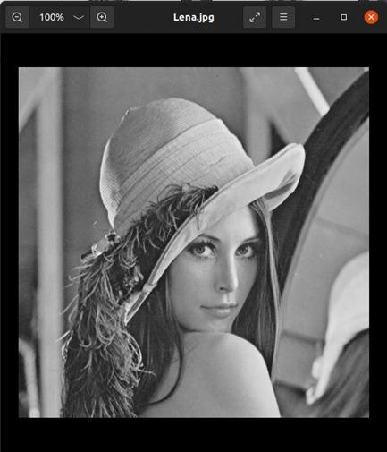
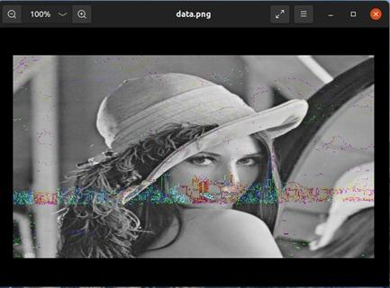
Results
Extracted Image from Video
Initial secret Image

Slide 5
THANK YOU

